Slide 1
3D Computer Vision
Dr. Hassan Foroosh
School of EECS
UCF

Slide 2
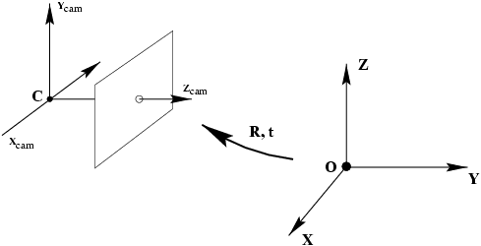
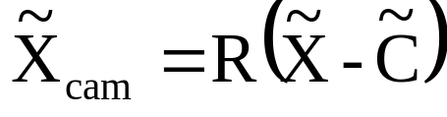
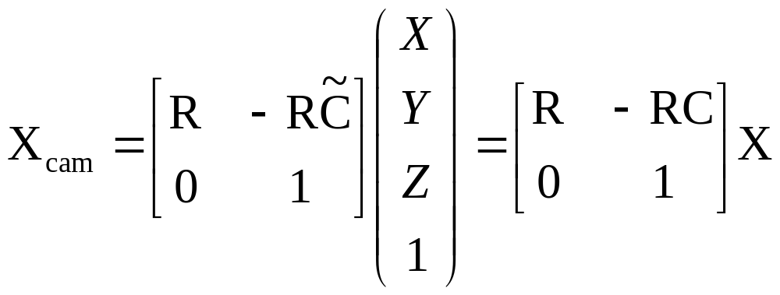
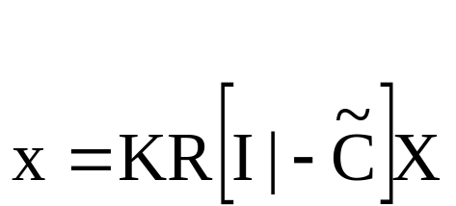
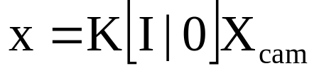

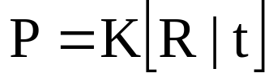
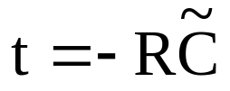
Last Lecture:
Pinhole Camera

Slide 3
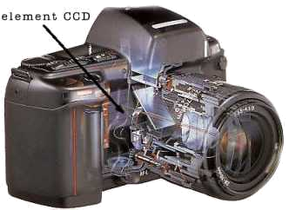
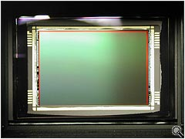
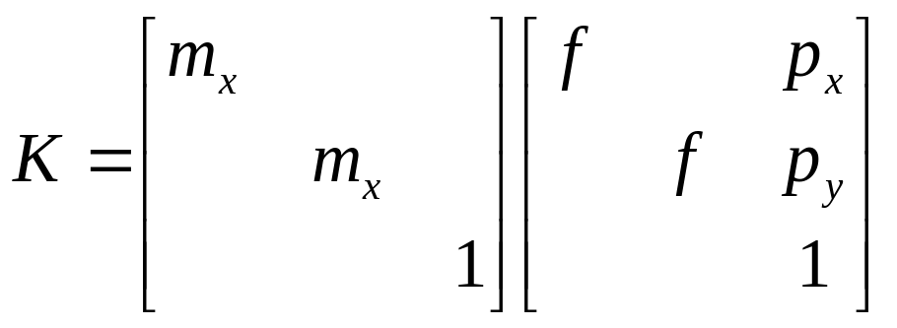
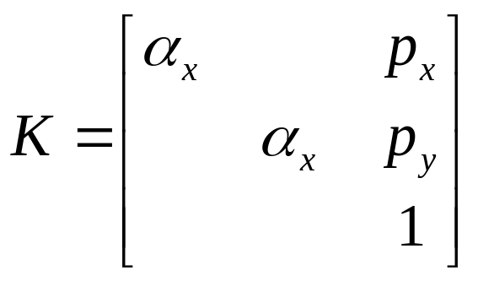
Last Lecture:
CCD Camera

Slide 4
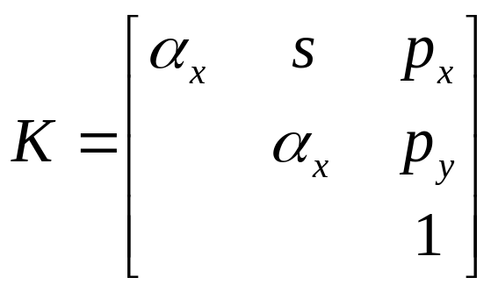
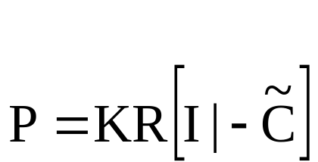
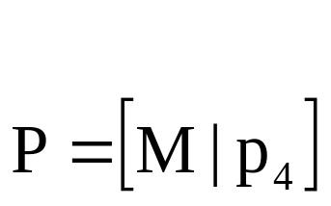
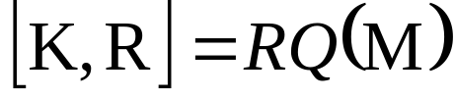
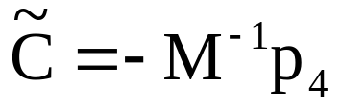
Last Lecture:
Finite Projective Camera
11 dof (5+3+3)
non-singular
decompose P in K,R,C?
{finite cameras}={P_{4x3} | det M≠0}
If rank P=3, but rank M<3, then cam at infinity

Slide 5
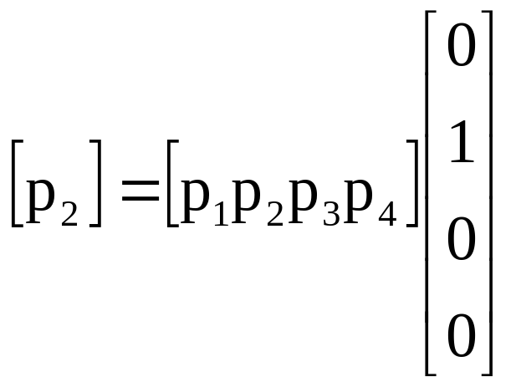
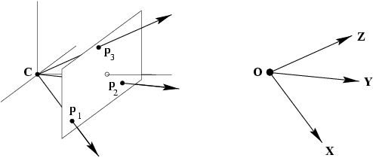
Last Lecture:
Column Vectors
Image points corresponding to X,Y,Z directions and origin

Slide 6
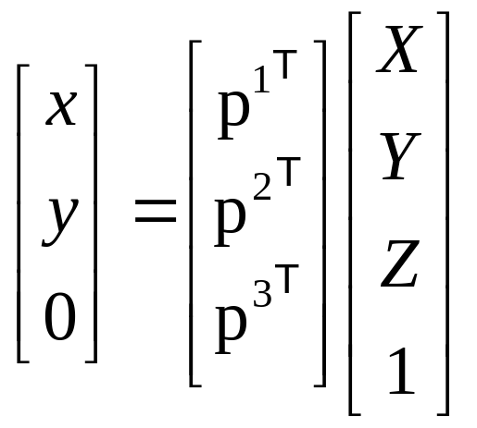
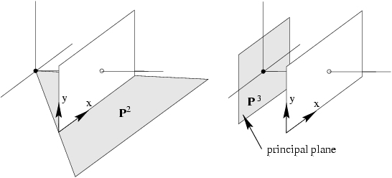
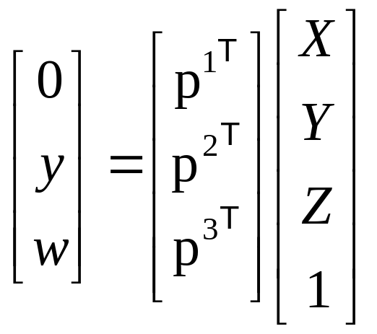
Last Lecture:
Row Vectors
note: p¹,p² dependent on image reparametrization

Slide 7

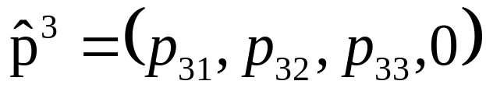
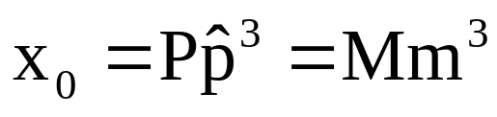
The Principal Point
principal point

Slide 8
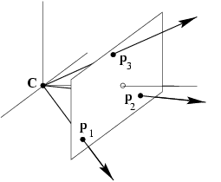

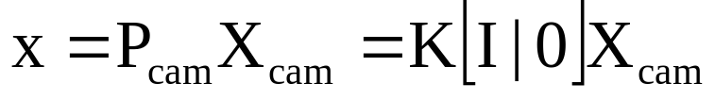
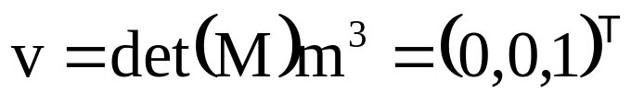
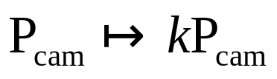

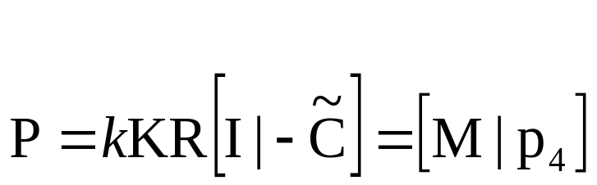
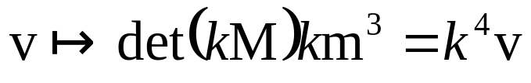

The Principal Axis Vector
vector defining front side of camera
(direction unaffected)
because

Slide 9
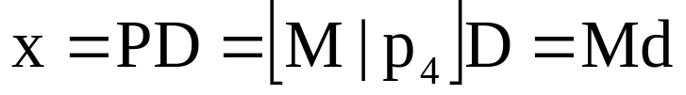


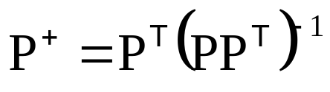

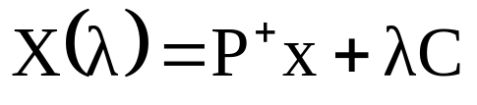

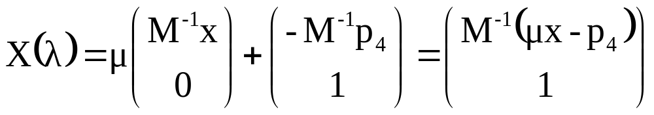


Action of Projective Camera on Points
Forward projection
Back-projection
(pseudo-inverse)

Slide 10





Camera Matrix Decomposition
Finding the camera center
(use SVD to find null-space)
Finding the camera orientation and internal parameters
(use RQ decomposition ~QR)
(if only QR, invert)
=( )⁻¹= ⁻¹ ⁻¹
R
Q
Q
R

Slide 11

When is skew non-zero?
arctan(1/s)
1
γ
for CCD/CMOS, always s=0
Image from image, s≠0 possible
(non coinciding principal axis)
resulting camera:

Slide 12
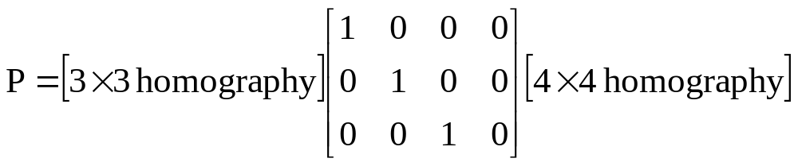
Euclidean versus Projective
general projective interpretation
Meaningfull decomposition in K,R,t requires Euclidean image and space
Camera center is still valid in projective space
Principal plane requires affine image and space
Principal ray requires affine image and Euclidean space

Slide 13
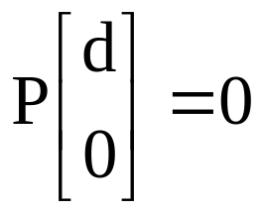

Cameras at Infinity
Camera center at infinity
Affine and non-affine cameras
Definition: affine camera has P^{3T}=(0,0,0,1)

Slide 14
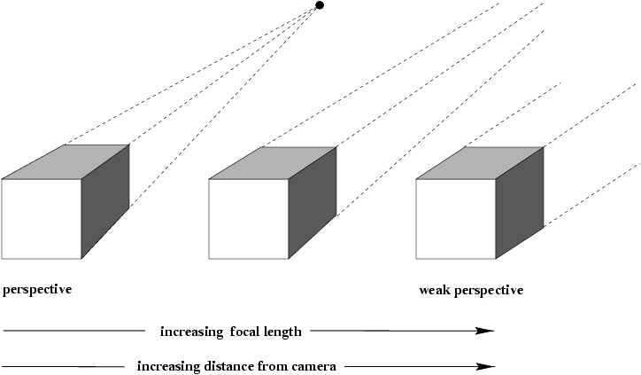
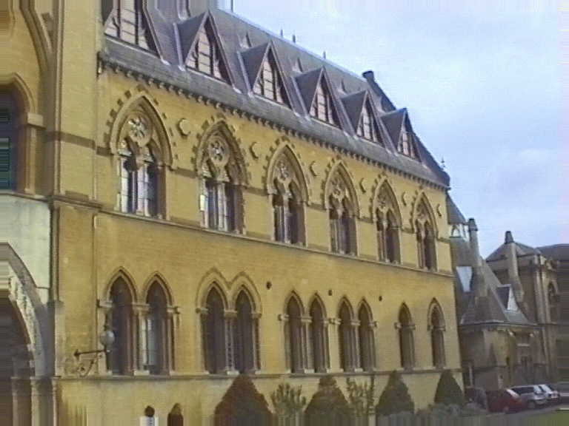
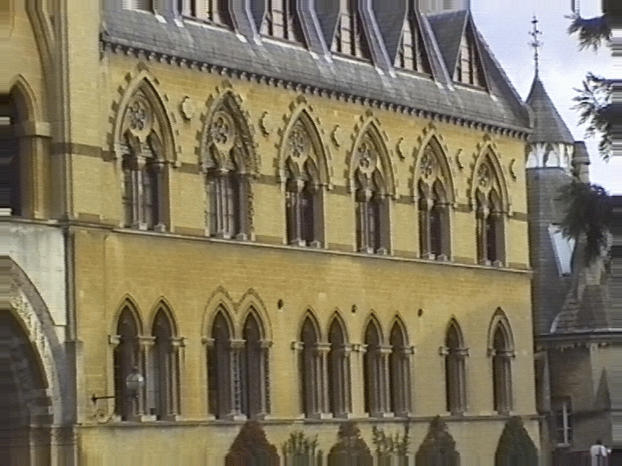
Affine Camera

Slide 15
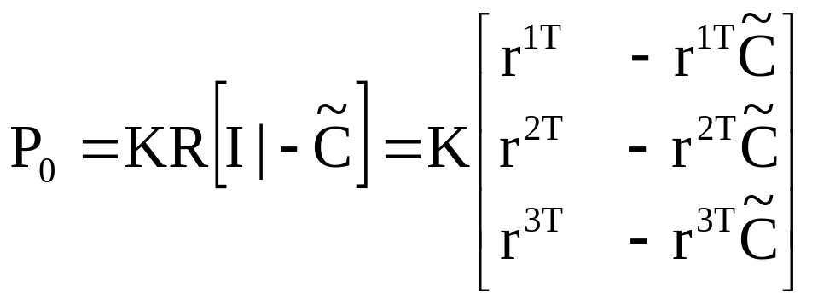
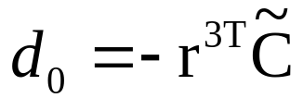
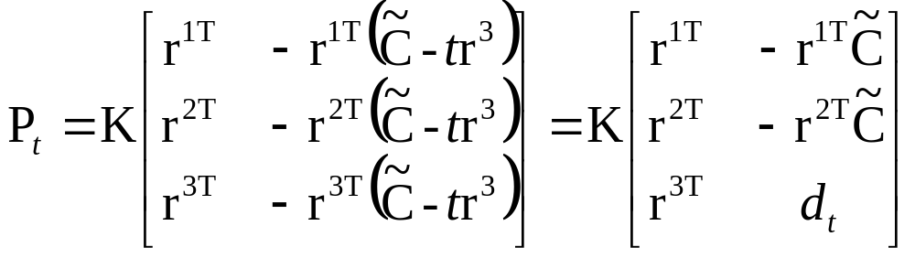
Affine Camera
modifying p₃₄ corresponds to moving along principal ray

Slide 16
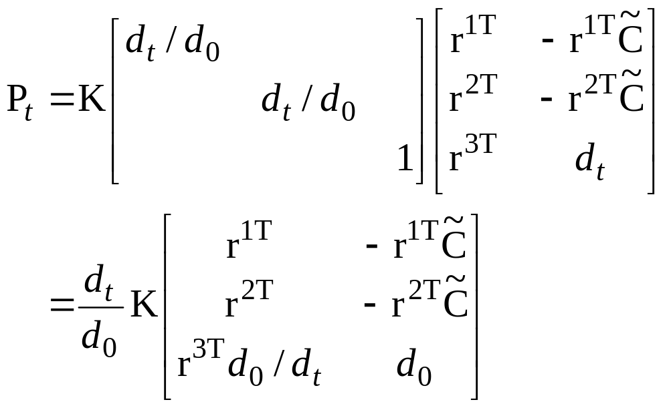
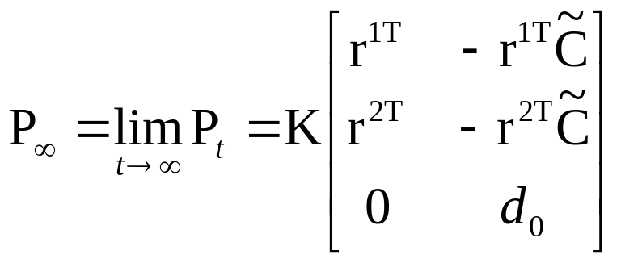
Affine Camera
now adjust zoom to compensate

Slide 17
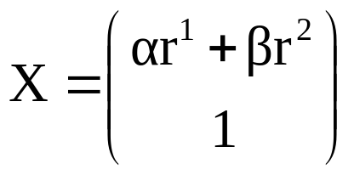

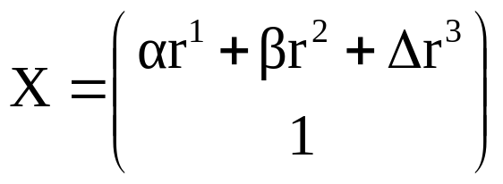
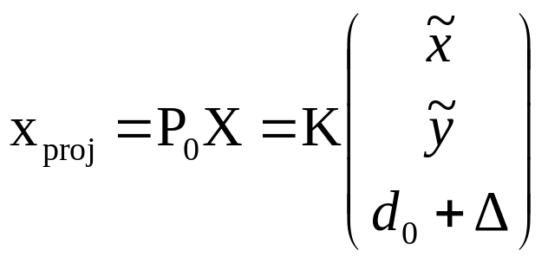
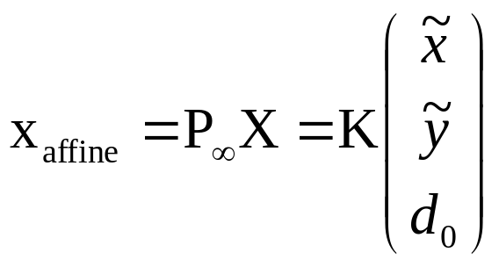
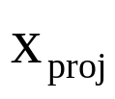


Error in Employing Affine Model
point on plane parallel with principal plane and through origin, then
general points

Slide 18
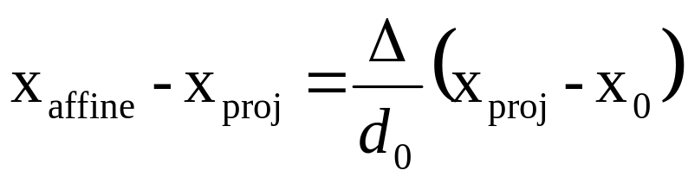
Affine Imaging Conditions
Approximation should only cause small error
Δ much smaller than d₀
Points close to principal point
(i.e. small field of view)

Slide 19
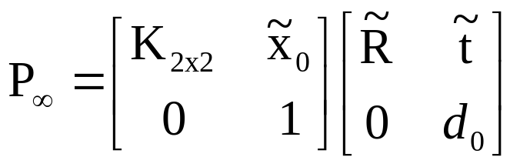



Decomposition of P∞
absorb d₀ in K_{2x2}
alternatives, because 8dof (3+3+2), not more

Slide 20


Summary of Parallel Projection
canonical representation
calibration matrix
principal point is not defined

Slide 21



A Hierarchy of Affine Cameras
Orthographic projection
(5dof)
Scaled orthographic projection
(6dof)

Slide 22


A Hierarchy of Affine Cameras
Weak perspective projection
(7dof)

Slide 23



A Hierarchy of Affine Cameras
Affine camera
(8dof)
Affine camera=camera with principal plane coinciding with Π∞
Affine camera maps parallel lines to parallel lines
No center of projection, but direction of projection P_{A}D=0
(point on Π∞)

Slide 24




Pushbroom Cameras
(11dof)
Straight lines are not mapped to straight lines!
(otherwise it would be a projective camera)

Slide 25


Line Cameras
(5dof)
Null-space PC=0 yields camera center
Also decomposition

Slide 26


Next class: Camera calibration

